Slide 1
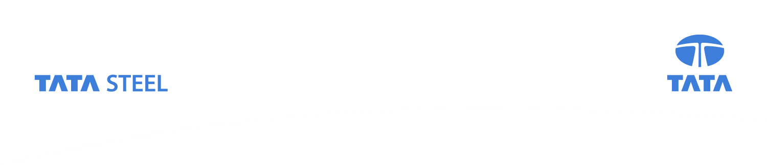
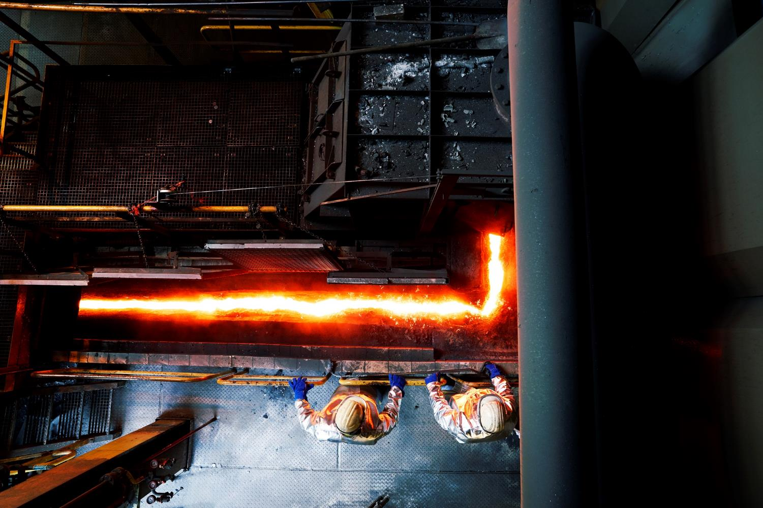
Presentation title, change View >> Header & Footer
The use of LD-slag as a fluxing agent
in the HIsarna Process
6th International Slag Valorisation Symposium
Christiaan Zeilstra, Hans Hage, Johan van Boggelen,
Koen Meijer, Pieter Broersen (all: Tata Steel, IJmuiden, the Netherlands)
Mechelen, Belgium
4 April 2019
Together we make the difference

Slide 2
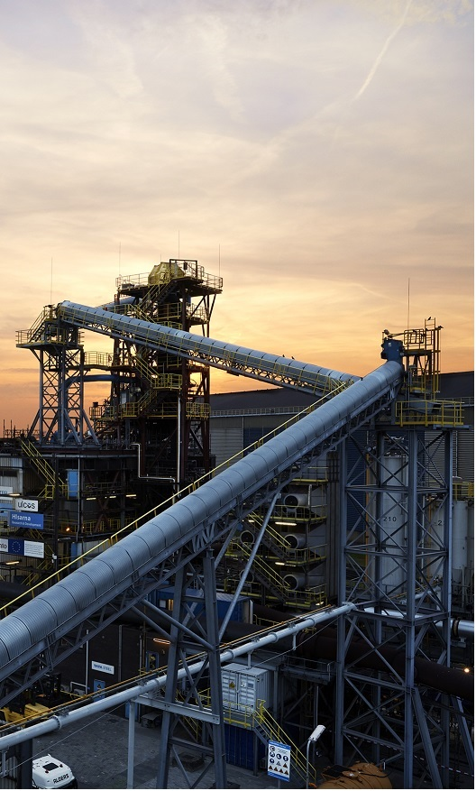
Content
1. What is HIsarna?
Hot metal and slag chemistry
Utilisation of LD-slag in HIsarna
4. Conclusions

Slide 3
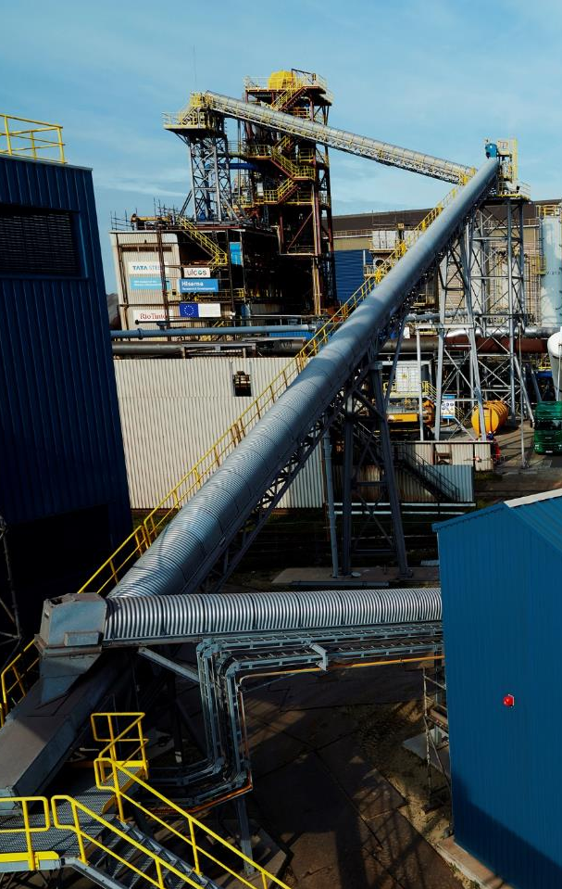
1.1 HIsarna development
HIsarna
  Smelting reduction ironmaking process that can achieve at least 20% reduction in CO₂ emission intensity without carbon capture technology (more than 80% possible with CCS).
  Oxygen based, therefore high CO₂ concentrations
Game changer technology
  Reduce CO₂ and other emissions
    No coking or ore agglomeration
  Flexible raw materials use

Slide 4

1.2 HIsarna development
In 2004 several European steelmakers proactively started the ULCOS project with the objective to achieve 50 % reduction of the CO₂ emissions of steelmaking
HIsarna is one of the four process development that originate from the ULCOS project.
Since 2007 Tata Steel, Rio Tinto and ULCOS have been active developing this coal-based smelting reduction process.
In 2010 a dedicated pilot plant was built at Tata Steel in IJmuiden (NL)
To date over 75 mln Euro has been invested in this new technology.
The HIsarna process offers a combination of environmental and economical benefits.

Slide 5




1.3 Comparison BF route - HIsarna
Iron ore
Hot metal
Coal
Coking/Agglomeration Ironmaking
Iron ore
Hot metal
Direct use of fine ores and coal
(no agglomeration and coking)
Coal
Ironmaking

Slide 6
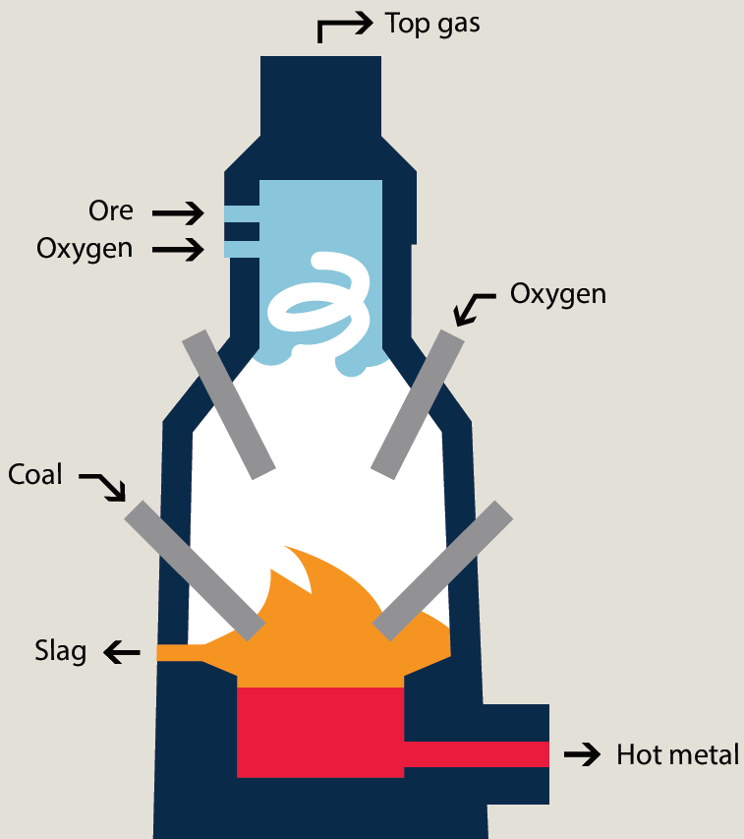
1.4. HIsarna – process layout
Iron ore is injected into the smelt cyclone, together with oxygen.
Hot CO rich gas from the SRV is combusted in the smelt cyclone, increasing the temperature and causing the iron to melt and partly pre-reduce.
The molten and partly reduced iron ore will form a liquid film along the wall of the cyclone after which it drops down into the slag layer in the SRV.
Granular coal is injected in the slag layer. This will fully reduce the iron ore to liquid hot metal and carburise the hot metal bath.
The reduction reaction produces CO gas. This is partly combusted with oxygen in the space between the top of the slag and bottom of the cyclone, in order to generate heat.
The splash and turbulence resulting from the injection processes ensure part of this heat is transported to the slag and metal bath.
Smelt Cyclone
SRV

Slide 7
1.5 HIsarna – Benefits
HIsarna offers a combination of environmental and economic benefits
Environmental benefits
Lower CO₂ emissions
Lower emissions SO_{X}, NO_{X}, dioxines and fine dust
Minimizing the landfilling of slags and dusts through recycling
Economic benefits
Ironmaking with low cost raw materials, non-coking coals and low grade ores.
Recycling of waste oxides, slags and galvanised scrap
Lower steelmaking costs because of low Si, P in hot metal
Greenfield developments with much lower CAPEX

Slide 8
2.1 Hot metal and slag chemistry
HIsarna uses fluxes for getting the right slag chemistry:
  Limestone - Pre-mix with iron ore
  Dolomite - Pre-mix with iron ore
  Burnt lime - ‘Finishing touch’
Replacing these fluxes with other sources of CaO and MgO:
  Reduce costs
  Lower CO₂ foot print
LD-slag is characterised by:
  Calcined
  Containing CaO: ~ 40 %wt
    B2 basicity ratio: CaO/SiO₂ ~ 3
  Containing MgO: ~ 7 %wt
  Containing Fe-units: ~ 18 %wt
  P₂O₅: ~ 1.5 %wt

Slide 9
2.2 Hot metal and slag chemistry
FeOx level in different slags:
  Blast Furnace: ~ 0.3 %wt
  HIsarna: ~ 4-5 %wt
  Steel convertor: ~ 20 %wt
FeOx level influences the partition of elements - such as P and Mn – over hot metal and slag:
  Blast furnace HM: P typically 0.05-0.10 %
  HIsarna HM: P typically 0.02 %
  Convertor (steel): P typically 0.007-0.02 %
  (Note that P-levels depend on raw material input)
HIsarna slag is better capable of dealing with increased P input than a blast furnace.
HIsarna is less effective in S removal than a blast furnace, but this can be done before the steelmaking step

Slide 10
3.1 Effect of LD-slag on ore feed fluxing
Factsage calculations were performed to assess the melting behaviour of the iron ore in the smelt cyclone. Cases studied:
  100 % iron ore;
  95.8 % iron ore, 2.5 % limestone and 1.7 % dolomite;
  95 % iron ore and 5 % LD-slag.
Observations:
  Fluxing of ore: better melting
  Fluxing with convertor slag should be similar/better as compared to limestone/dolomite.

Slide 11
3.2 HIsarna plant trials using LD-slag
A pilot plant trial was performed in order to assess the impact of fluxing with LD-slag:
IJmuiden LD-slag was ground/screened to prepare ~ 2000 tons of iron ore / LD-slag blend;
This blend was used during ~ 20 days of hot metal production
Hot metal and slag chemistry were compared with ‘regular’ fluxed iron ore (limestone/dolomite)
Observations:
HIsarna process behaviour/control was unchanged:
  Control of the smelt cyclone (iron ore injection);
  Control of the final (tapped) slag chemistry/basicity.
Differences in hot metal and slag compositions observed:
  Increased P and V levels in hot metal and slag, originating from the LD-slag;
Table: Average HIsarna slag and metal compositions for test runs with two different ore feed blends. Note the reported Fe_{tot} in the slag is present as FeOx.

Slide 12
4. Conclusions / outlook
HIsarna is a break-through technology, offering significant environmental and economic benefits.
Plant trials were performed:
Demonstrating capability of utilising/recycling LD-slag in order to reclaim CaO, MgO and Fe units;
Observed that P levels in the hot metal went up, but were still low compared to those of typical blast furnace hot metal.
  Lower P-levels will reduce costs of steelmaking;
  Capability of taking increased P input.
Further study/testing to be done:
Better understand/optimise element partitioning over hot metal and slag, e.g., P, Mn and V;
Effects of mineralogical phases of fluxes on melting behaviour of iron ore in the smelt cyclone;
More general: investigate the differences between HIsarna slag and blast furnace slag for cement making applications.

Slide 13

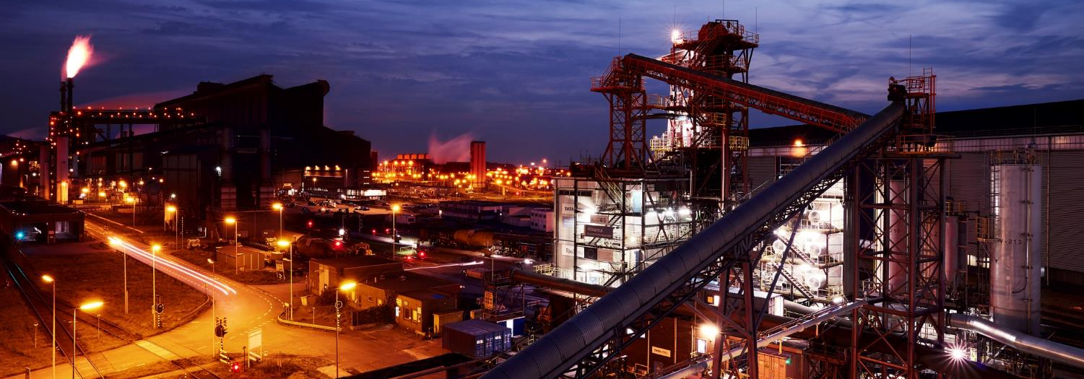
Acknowledgements
HIsarna is being developed together with ArcelorMittal, thyssenkrupp, voestalpine and Paul Wurth.
This project has received funding from the European Union’s Horizon 2020 research and innovation programme under grant agreement No 654013.

